Slide 1


Institute Technology of Cambodia
Subject : Data Mining
Topic :
Heart Disease Prediction
Lecturers:
PHAUK Sokkhey and CHAN Sophal
Class : M1 Computer Science
Student’s name : SOEUM Zera

Slide 2
Contents
Introduction
Dataset Description
Work Flow
Data Analysis
Models and Results
Prediction Model
Conclusion and Future work

Slide 3
1. Introduction
What is Heart Disease?
It describe about range conditions of heart.
The term “heart disease” is often used interchangeably with the term “cardiovascular disease”.
According to WHO about 610,000 people die of heart disease in the United States every year–that’s 1 in every 4 deaths
Around 17 million people die due in Cardiovascular Disease (CVD) every year world wide.

Slide 4
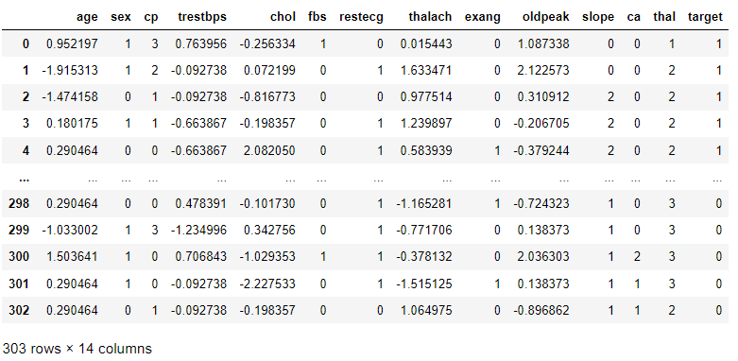
2. Dataset Description
Dataset name ‘ heart.csv’ , it consists 303 rows and 14 columns

Slide 5



3. Work Flow
Dataset
Data Processing
Split Train&Test
Logistic Regression Model
KNN Model
RF Model
Healthy
Best Train Model
Disease
New data

Slide 6
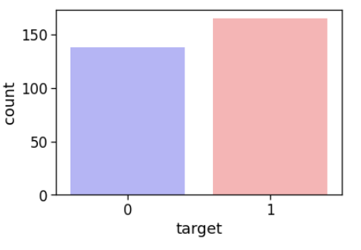
4. Data Analysis
0 : No disease
1 : Have disease
In data, we see people is getting disease more than none disease

Slide 7
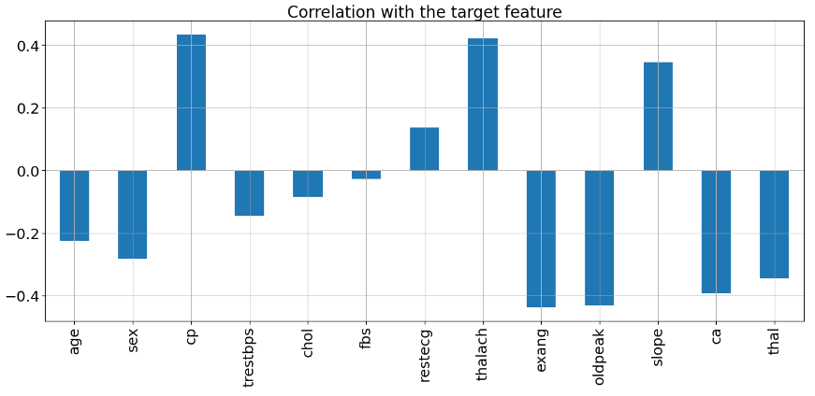
4. Data Analysis
Four feature( “cp”, “restecg”, “thalach”, “slope” ) are positively correlated with the target feature.
Other features are negatively correlated with the target feature.

Slide 8
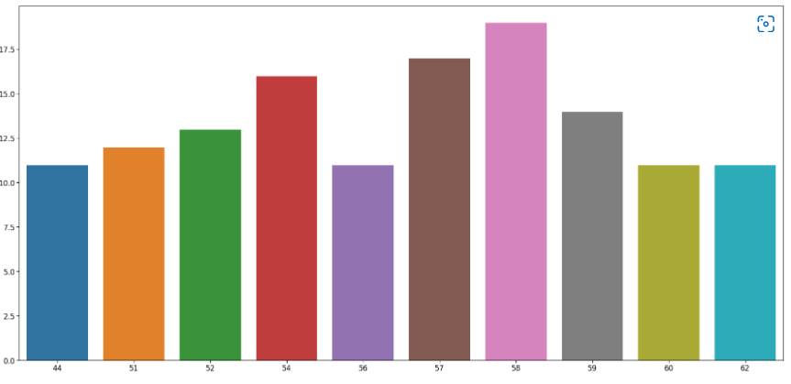
4. Data Analysis
Here we can see that the 58 age column has the highest frequency.

Slide 9
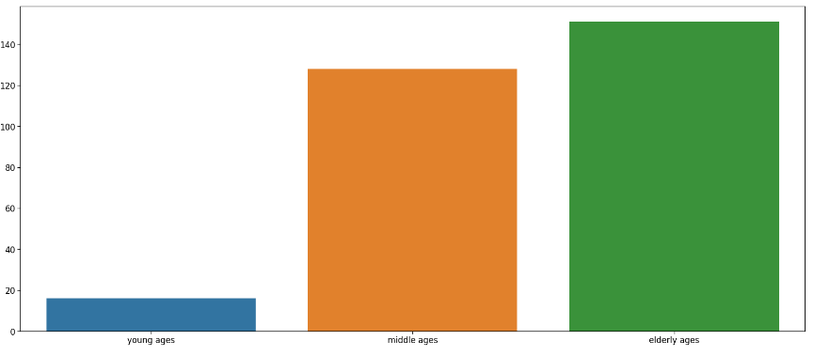
4. Data Analysis
Here we can see that elder people are the most affected by heart disease and young ones are the least affected.

Slide 10
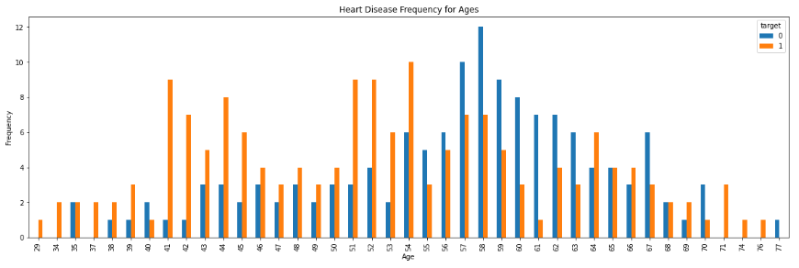
4. Data Analysis

Slide 11
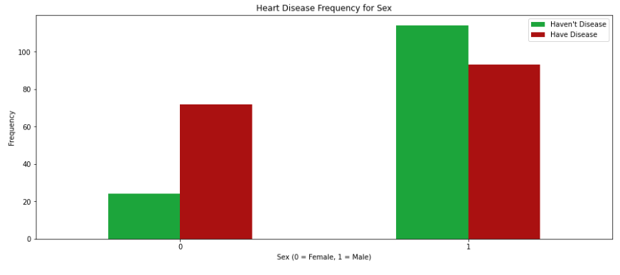
4. Data Analysis

Slide 12
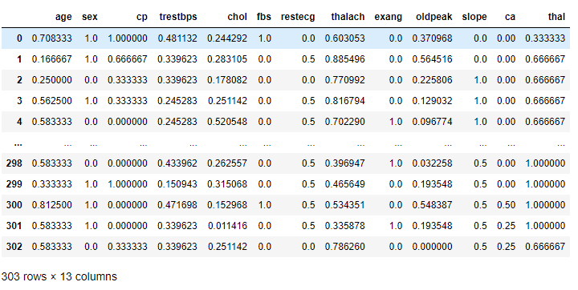
5. Models and Results
Drop column ‘target’ and use it as output ‘y’
13 column use as data ‘x’
Training size 80% and Testing 20%

Slide 13
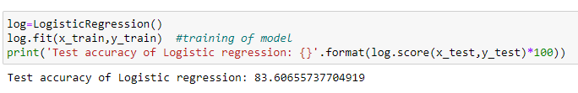
5. Models and Results
Logistic Regression
Logistic regression is a process of modeling the probability of a discrete outcome given an input variable. The most common logistic regression models a binary outcome; something that can take two values such as true/false, yes/no, and so on.

Slide 14
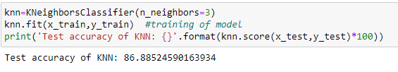
5. Models and Results
Kneighborsclassifier
It is a supervised learning algorithm that makes classifications based on data neighbors (k).

Slide 15
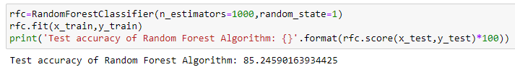
5. Models and Results
Random Forest
Random forest is a Supervised Machine Learning Algorithm that is used widely in Classification and Regression problems. It builds decision trees on different samples and takes their majority vote for classification and average in case of regression

Slide 16
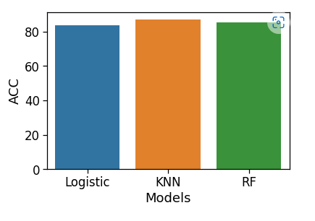
5. Models and Results

Slide 17
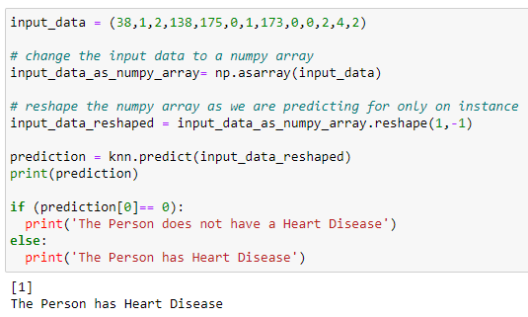
6. Prediction model

Slide 18
7. Conclusion and Future work
Conclusion
We have also interpreted best performing algorithm is KNN algorithm (86.88%)
We did data visualization and data analysis of the target variable, age features
Future Work
Improve higher accuracy with more than algorithms
Make a system of heart prediction

Slide 19
Thank You! Any Question?

